Slide 1
Child Health and Wellbeing Tracker CE201 – Team Project Challenge Team 34: Sneha Tandon, Leo Tovell, Sarfaraz Mohammed, Saif Wasi, Chloe Yammine, Cayan Deniz Kucuktopana

Slide 2
Project Overview

Slide 3

Project Overview
The Child Health & Well-Being Tracking Software is a tool for parents and caregivers to monitor and manage their children's health.
It provides an intuitive, user-friendly interface for the following features:
Sleep Tracking
Feeding Habits
Diaper changes
Temperature tracking
Overall growth
Medicine administration
Along with these features, it allows the users to generate PDF report and gain insights into the child's progress
Notes:
PROJECT OVERVIEW
Brief introduction to project:
The Child Health & Well-Being Tracking Software is a tool for parents and caregivers to monitor and manage their children's health.
The problem aimed to solve and the motivation behind it:
It provides an intuitive, user-friendly interface for tracking daily activities like sleep, feeding, diaper changes, temperature, growth, and medication administration, by generating visual insights in the form of graphs. This allows the users to recognize patterns and trends over time, simplifying their child’s daily health routine and enabling informed decision-making.
This software can also aid pediatricians and child health specialists, by generating reports to facilitate tracking and discussing the child's growth and overall health progress.
Target users: Parents, caregivers, pediatricians/child health specialists
Use cases: Sleep tracking, feeding tracking, diaper change tracking, temperature tracking, growth tracking, medication administration tracking, generating reports

Slide 4
Technical Implementation

Slide 5
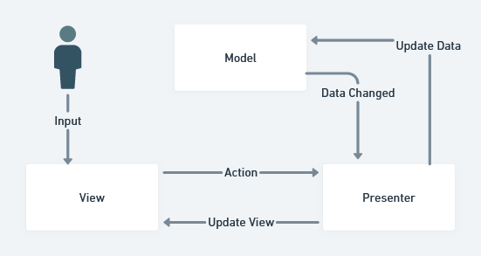
Technical Implementation
The project follows a modular scalable architecture to ensure scalability and maintainability, moreover, it follows MVP (model – view – presenter) pattern.
Notes:
TECHNICAL IMPLEMENTATION
Overview of the system architecture and key components.
Technologies and tools used.
Any significant challenges faced and how they were overcome.

Slide 6
Technical Implementation
Frontend:
JavaFX
Swing
Backend:
JDBC
Junit
Database:
Postgresql
JDBC
TXT File Storing (Configuration, Settings & Parameters)
Data Analytics & Reporting:
JFreeChart
JfreeUnit
iTextPDF
Notes:
TECHNICAL IMPLEMENTATION
Overview of the system architecture and key components.
Technologies and tools used.
Any significant challenges faced and how they were overcome.

Slide 7
Demonstration of the Final Product

Slide 8
Demonstration of the Final Product
The core features of our application include:
User registration and profile management – stakeholders can create an account and manage their profiles for tracking child health data. Users sign up with basic details and once logged in, they can create children’s profile(s) which will be stored in the database.
Child health data tracking – enables users to log and track key health metrics which include growth, sleep, feeding & more. The data entered can be height, weight, hours of sleep, type of food, medication, temperature, etc. This data can be saved and updated anytime.
Visualization and reports – provides visual insights and reports based on the data tracked, which helps parents/caregivers/doctors to make informed decisions. The data entered is analyzed and displayed in the form of graphs & charts. These will display the data entered over time, additionally, reports can be generated in a PDF form with overall information.
Notes:
DEMONSTRATION OF THE FINAL PRODUCT
Walkthrough of the core features of your application.
Key functionalities and how they work.

Slide 9
Demonstration of the Final Product
4) Health history tracking – tracking a child’s health history which can include past illness, doctors visit, and treatments. This feature allows the users to enter historical health information which can be accessed anytime.
5) Multi-user support – allows the user to add multiple children under the same user account.
6) Data exported in the PDF, graph, and chart form which is mentioned before.
7) Dashboard – a user-friendly interface for managing health data. This way all sections can be seen and can be accessed by the user easily.
Notes:
DEMONSTRATION OF THE FINAL PRODUCT
Walkthrough of the core features of your application.
Key functionalities and how they work.

Slide 10
Project Management and Development Process

Slide 11
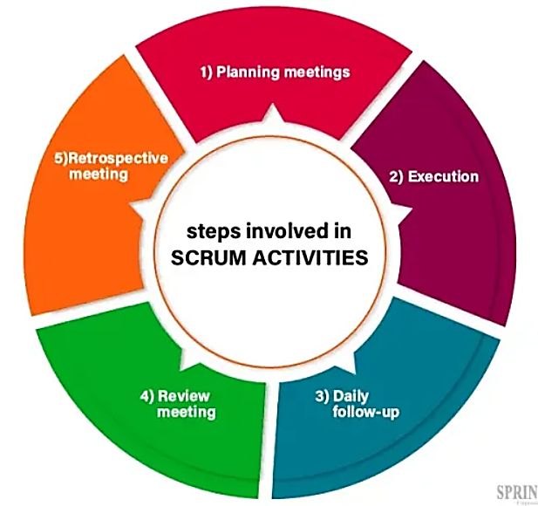
Project Management and Development Process
This project utilized the Scrum methodology to manage tasks, deliver continuous progress, and maintain team communication. This was achieved by using Jira and GitLab for project management and collaboration.
Development was divided into sprints, where planning these sprints and tracking their progress occurred during the weekly in-lab sessions. We also used this time to review completed features, as well as gather feedback and support from each other. Retrospectives were conducted to identify areas for improvement and optimize processes for following sprints.
Notes:
PROJECT MANAGEMENT AND DEVELOPMENT PROCESS
Agile methodologies followed:
This project utilized the Scrum methodology to manage tasks, deliver continuous progress, and maintain team communication. This was achieved by using Jira and GitLab for project management and collaboration. Development was divided into sprints, where planning these sprints and tracking their progress occurred during the weekly in-lab sessions. We also used this time to review completed features, as well as gather feedback and support from each other. Retrospectives were conducted to identify areas for improvement and optimize processes for following sprints.

Slide 12
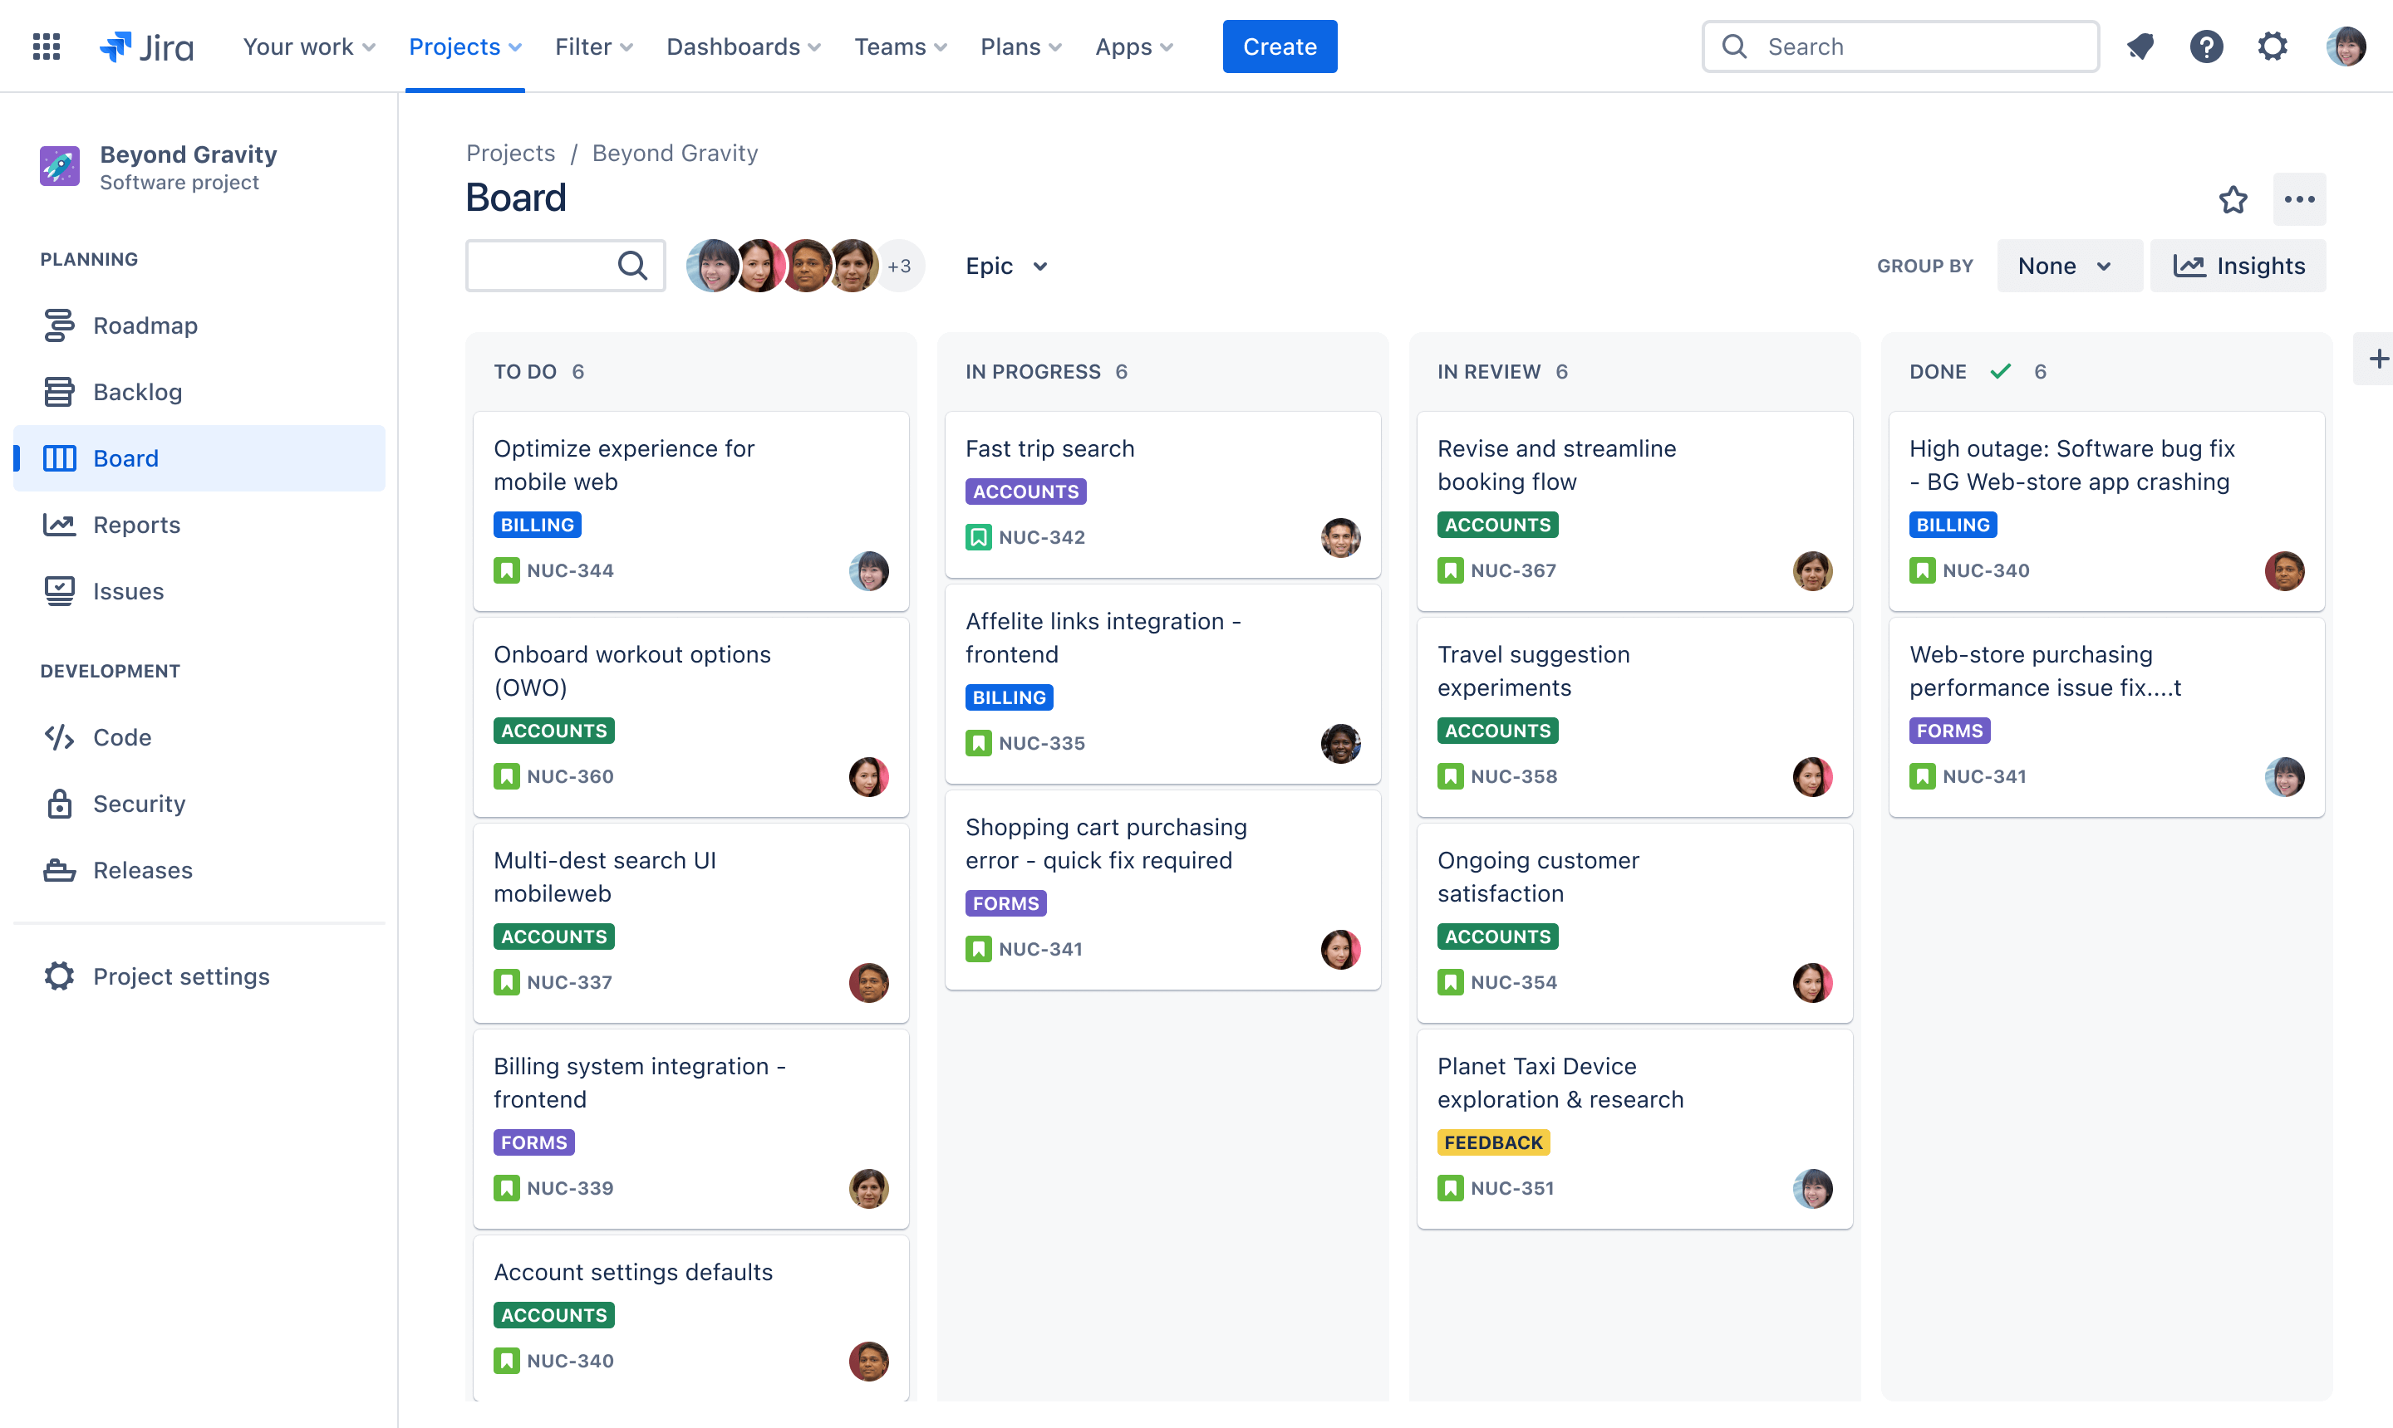
Project Management and Development Process
Jira managed tasks, sprints, and user stories, breaking them down into individual tasks and using Kanban workflow boards to track progress. This helped maintain a clear backlog and ensured timely completion of tasks.
Example Kanban workflow board
GitLab was the primary tool for version control and collaborative coding, maintaining a single repository and allowing efficient work on individual features without disrupting the main codebase. Its branching and merging capabilities ensured code quality through peer reviews and automated testing.
Notes:
PROJECT MANAGEMENT AND DEVELOPMENT PROCESS
Use of Jira and GitLab for collaboration:
Jira managed tasks, sprints, and user stories, breaking them down into individual tasks and using Kanban workflow boards to track progress. This helped maintain a clear backlog and ensured timely completion of tasks. GitLab was the primary tool for version control and collaborative coding, maintaining a single repository and allowing efficient work on individual features without disrupting the main codebase. Its branching and merging capabilities ensured code quality through peer reviews and automated testing.

Slide 13
Individual Contributions

Slide 14
Leo
Focus on programming
- General page structure (code not UI) - Modularisation of code
- Bug fixes
Market research
- Sprout
Report writing
- Technical Description
- Team Effort Log

Slide 15
Sneha
SQL integration
Used MySQL code from Chloe and made sure it was optimum with PostgreSQL
Establishing database
Making sure all tables are formed and integrated well with java
Database connection (with Leo)
Made sure database was well connected and easy to make connection when application run in any device
PDF
Used Itextpdf so a final report with all data can be presented and extracted by users
Page formations
Made basic formation of pages so others can do the gui for them

Slide 16
Sarfaraz
Research
Requirements into user stories
Researching the competition
The market plan ( Economics )
Report
Research into readable format into the report
Team effort log

Slide 17
Saif
Code:
Data input validation(add child page)
Bug fixes
GUI pages
Report:
team effort log
marketing plan
Reasearch:
market reasearch

Slide 18
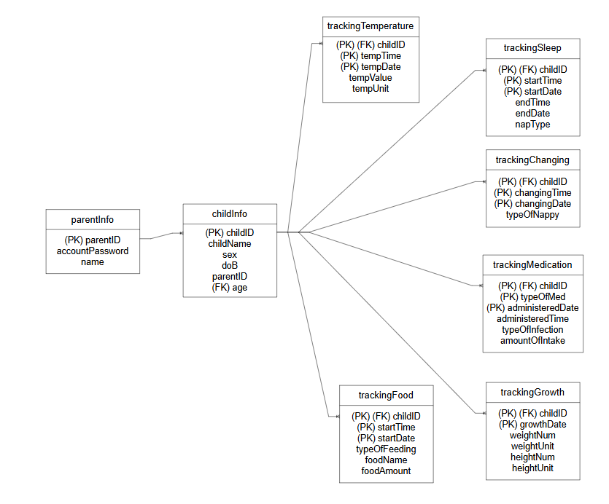
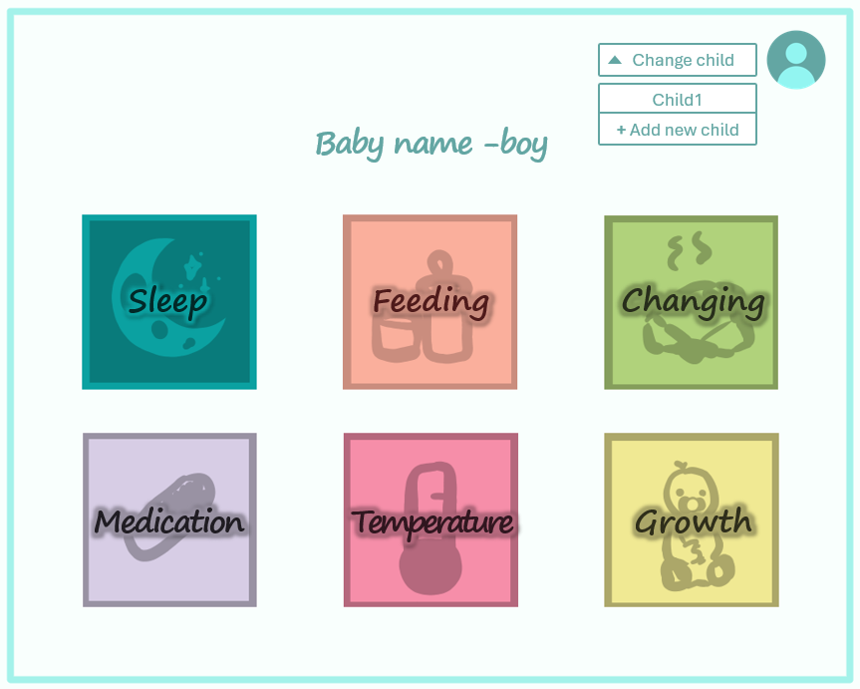
Chloe
Database design
-Created tables based on required data and normalizing them into 3NF
-SQL code
Design mockup & GUI implementation
-Design idea to know how the application should ideally look like & code

Slide 19
Cayan Deniz
Programming:
Initial graph codes
Unit testing (JUnit)
Initial Product:
Wireframe designs
Report:
ProductContext
Team Effort Log

Slide 20
Testing and Evaluation

Slide 21
Testing and Evaluation
The Manual testing covers:
Database connection verification
PDF report generation
The Integration testing covers:
Database integration
Health data synchronization
Report generation & PDF export
Junit testing covers: All pages
Notes:
TESTING AND EVALUATION
Summary of testing strategies (unit tests, integration tests, user testing).
Findings and improvements made based on testing.

Slide 22
Future Improvements and Reflection

Slide 23

Future Improvements and Reflection
The existing iteration of the Child Health & Well-Being Tracking Software presents certain limitations, including the absence of multi-user functionality and a lack of advanced analytical tools. To advance the project, it is essential to focus on enhancements such as the introduction of multi-user support, the incorporation of AI-driven health insights, and the creation of a mobile application.
Throughout the development process, we recognized the significance of user feedback, which has been instrumental in guiding design enhancements, and the vital importance of thorough testing to detect and resolve issues at an early stage. These insights will contribute to the refinement of future versions and the overall enhancement of user experience.
Notes:
FUTURE IMPROVEMENTS AND REFLECTION
Limitations of the current version:
The existing iteration of the Child Health & Well-Being Tracking Software presents certain limitations, including the absence of multi-user functionality and a lack of advanced analytical tools.
Potential improvements and next steps.
To advance the project, it is essential to focus on enhancements such as the introduction of multi-user support, the incorporation of AI-driven health insights, and the creation of a mobile application.
Lessons learned from the project:
Throughout the development process, we recognized the significance of user feedback, which has been instrumental in guiding design enhancements, and the vital importance of thorough testing to detect and resolve issues at an early stage. These insights will contribute to the refinement of future versions and the overall enhancement of user experience.

Slide 24
Thank you!
[picture of the team, maybe]

